Slide 1


AtliQ hardware: business insights

Slide 2
agenda
Business Model
Tools Used
Learnings
Problem Statement
Reports

Slide 3
Business model
AtliQ Hardware sell Computer hardware to different customers (retail store like croma, bestbuy, etc. & e-commerce platforms), these stores will sell these products to consumers. AtliQ Hardware deals in two types of platforms Brick & Mortar (croma, bestbuy) and E-commerce (flipkart, amazon). They sell their product through three different channels i.e. Retailer (croma, flipkart), Direct (atliq exclusive) and distributor.

Slide 4
Tools Used
Programming Language
SQL
Database
MySQL

Slide 5
learnings
Joins
Sub-Queries
Common Table Expressions (CTEs)
Aggregate functions
User Defined Functions
Stored Procedure
Views
Temporary Tables
Window Functions
Entity Relationship Diagrams (ERD)

Slide 6
1. Croma India Product wise Sales Report
To generate a report of individual product sales (aggregated on a monthly basis at the product code level) for Croma India for FY 2021 in order to track product sales and run further product analytics.
Report should include the following:
Month
Product name
Variant
Sold quantity
Gross price per item
Gross price total

Slide 7
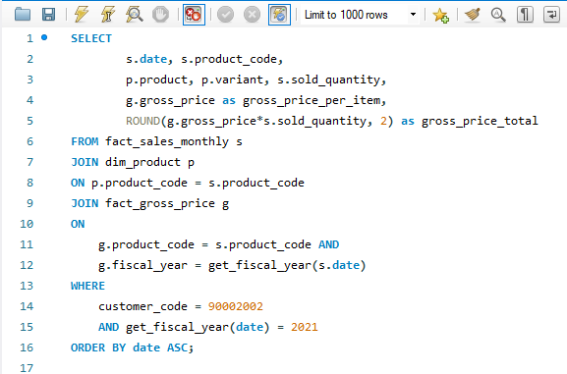
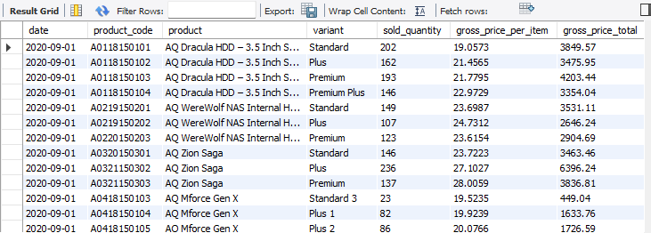

Slide 8
2. Gross Monthly total sales report for Croma
Prepare an aggregate monthly gross sales report for Croma India customer in order to track the monthly sales the particular customer is generating for AtliQ and manage their relationship accordingly.
Report should include the following:
Month
Total gross sales amount to Croma India in this month.

Slide 9
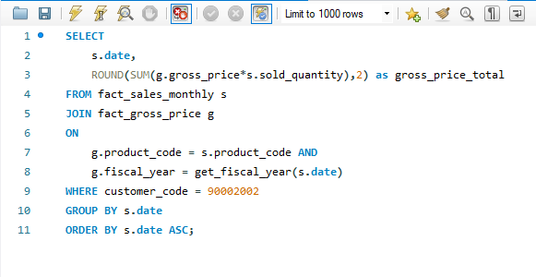
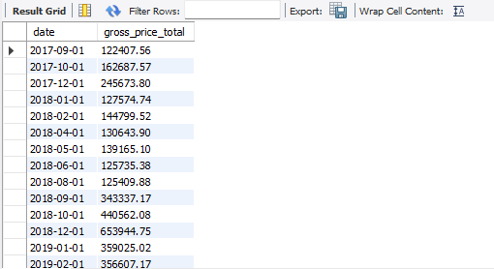

Slide 10
3. STORED PROCEDURE FOR MARKET BADGE
Create a stored procedure that can determine the market badge on the following logic.
If total sold quantity > 5 million that market is considered GOLD else it is SILVER.
Inputs will be
Market
Fiscal year
Output
Market Badge

Slide 11
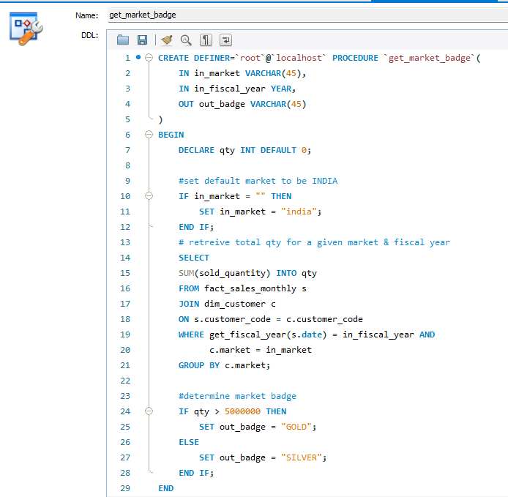

Slide 12
4. NET SALES REPORT
Generate a report for top markets, products, customers by net sales for a given financial year in order to track the company’s financial performance and to take any appropriate actions to address any potential issues.

Slide 13
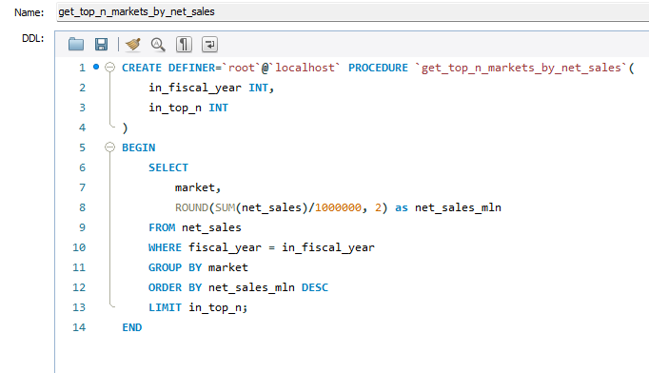
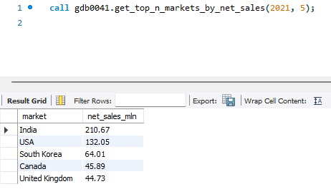
Report for Top Markets:
Rank
Market
Net sales (millions)

Slide 14
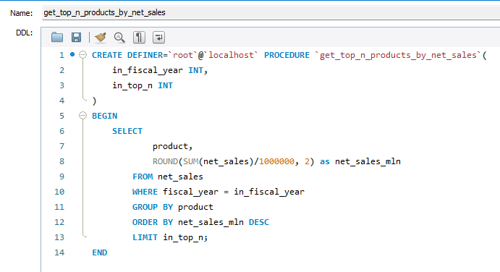
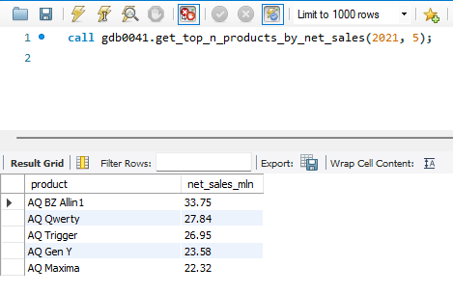
Report for Top Products:
Rank
Product
Net sales (millions)

Slide 15
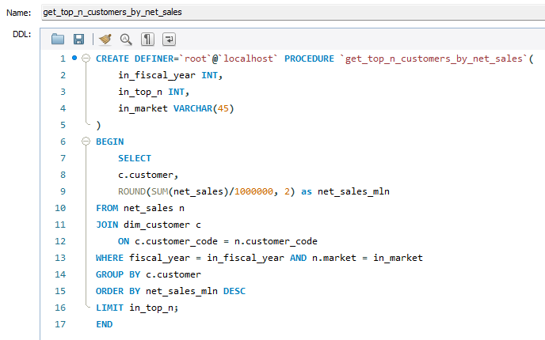
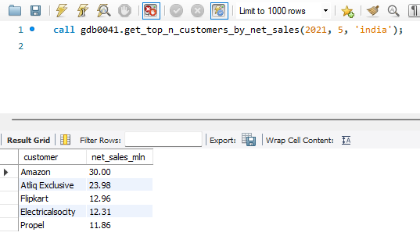
Report for Top Customer:
Rank
Customer
Net sales (millions)

Slide 16
5. NET SALES Global market share % bar chart
Create a bar chart report for FY 2021 for top 10 markets by %age net sales.

Slide 17
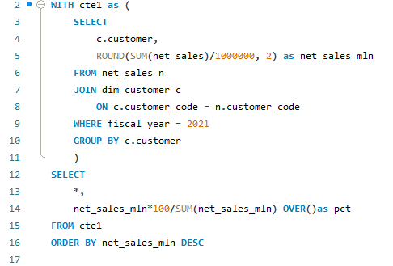
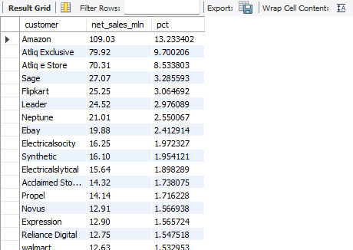

Slide 18
6. NET SALES share % by region
Create a region wise (APAC, EU, LTAM etc.) net sales % breakdown by customers in a respective region so that a regional analysis can be performed on financial performance of company.
The end result should be a pie chart for the FY 2021.

Slide 19
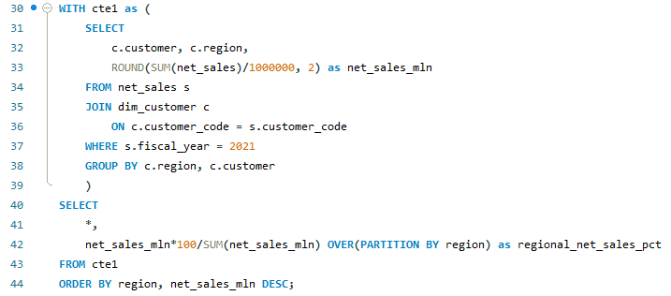
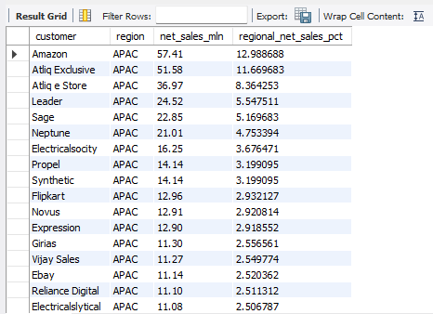

Slide 20
7. Get top n products in each division by their quantity sold
Write a stored procedure for getting top n products in each division by their quantity sold in a given financial year.

Slide 21
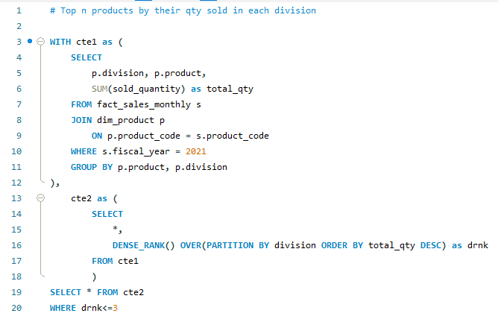
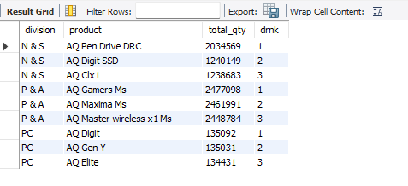

Slide 22
8. Forecast accuracy for all customers for a given fiscal year
To generate a forecast accuracy report for all customers for a given fiscal year, in order tot rack the accuracy of forecast is being made for all customers.
The report should have the following fields:
Customer code, Name, Market
Total sold quantity
Total forecast quantity
Net error
Absolute error
Forecast accuracy%

Slide 23
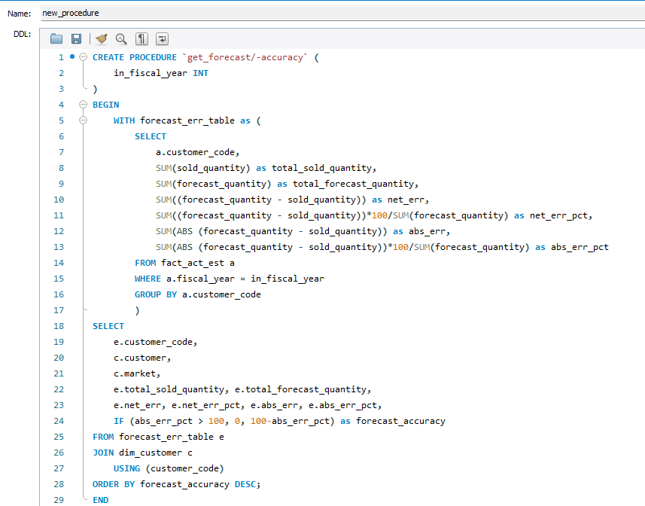
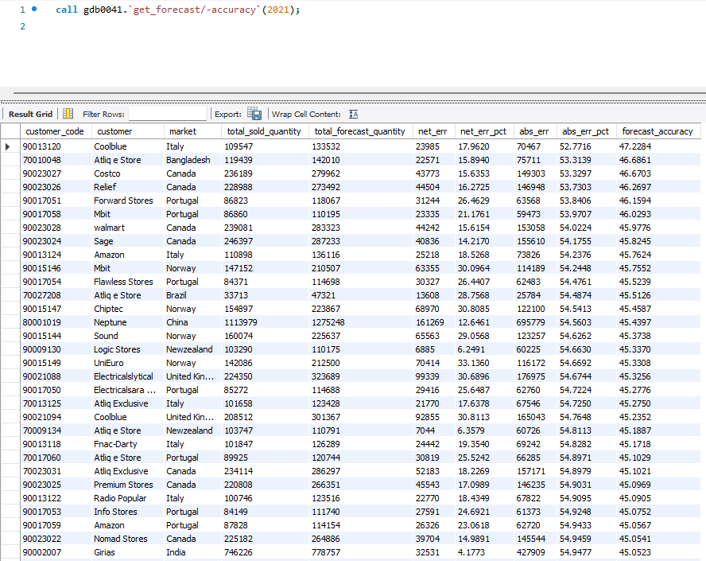

Slide 24
9. Forecast accuracy difference between fy 2020 & 2021
The supply chain business manager wants to see which customers’ forecast accuracy has dropped from 2020 to 2021. Provide a complete report with these columns: customer code, customer name, market, forecast accuracy 2020 & forecast accuracy 2021.

Slide 25
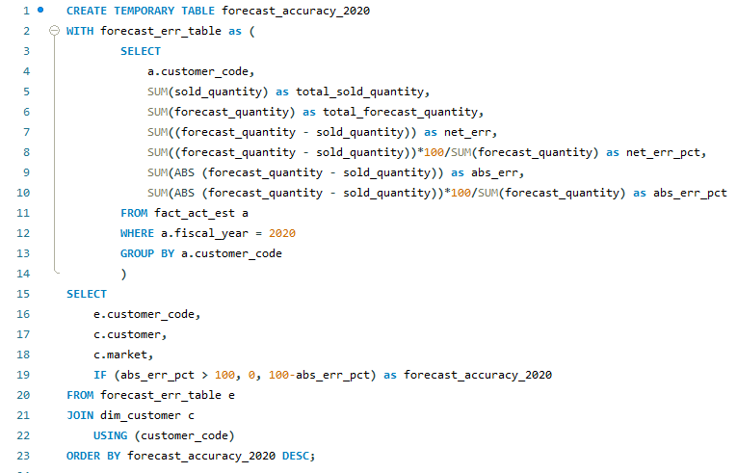
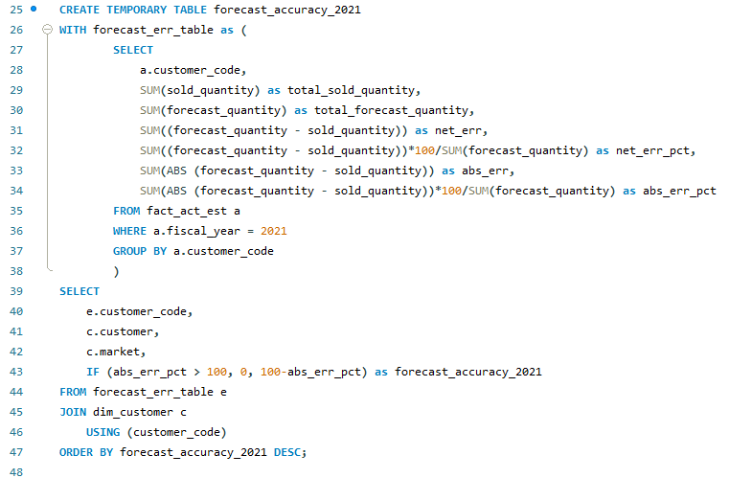

Slide 26
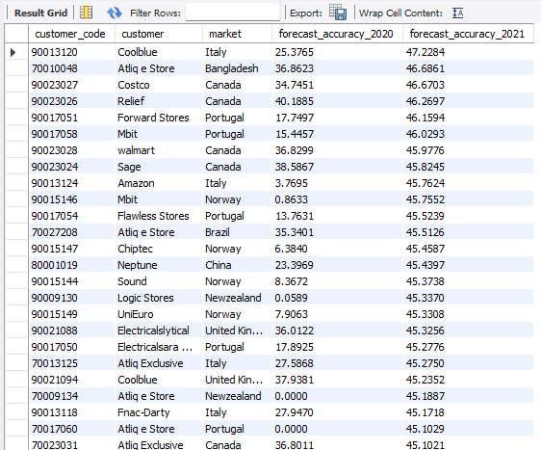
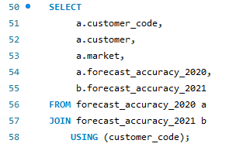

Slide 27
Thank you

